Slide 1

Doing the HSC Minimum Standards tests…

Slide 2

There are three tests, all on-line, each test taking 45 minutes:

Slide 3
There are three tests, all on-line, each test taking 45 minutes:
reading test (45 multiple-choice questions);

Slide 4
There are three tests, all on-line, each test taking 45 minutes:
reading test (45 multiple-choice questions);
numeracy test (45 multiple-choice questions);

Slide 5
There are three tests, all on-line, each test taking 45 minutes:
reading test (45 multiple-choice questions);
numeracy test (45 multiple-choice questions);
writing test (500 words maximum).

Slide 6
There are three tests, all on-line, each test taking 45 minutes:
reading test (45 multiple-choice questions);
numeracy test (45 multiple-choice questions);
writing test (500 words maximum).
…and no two tests are the same.

Slide 7

All Year 10 will take the tests in Week 9 of this Term.

Slide 8
All Year 10 will take the tests in Week 7 of this Term.
Those who achieve the minimum standard never have to take that test again.

Slide 9
All Year 10 will take the tests in Week 7 of this Term.
Those who achieve the minimum standard never have to take that test again.
Those who don’t achieve the minimum standard are allowed to re-take the tests up to four times a year, but there has to be a 30-day gap.

Slide 10
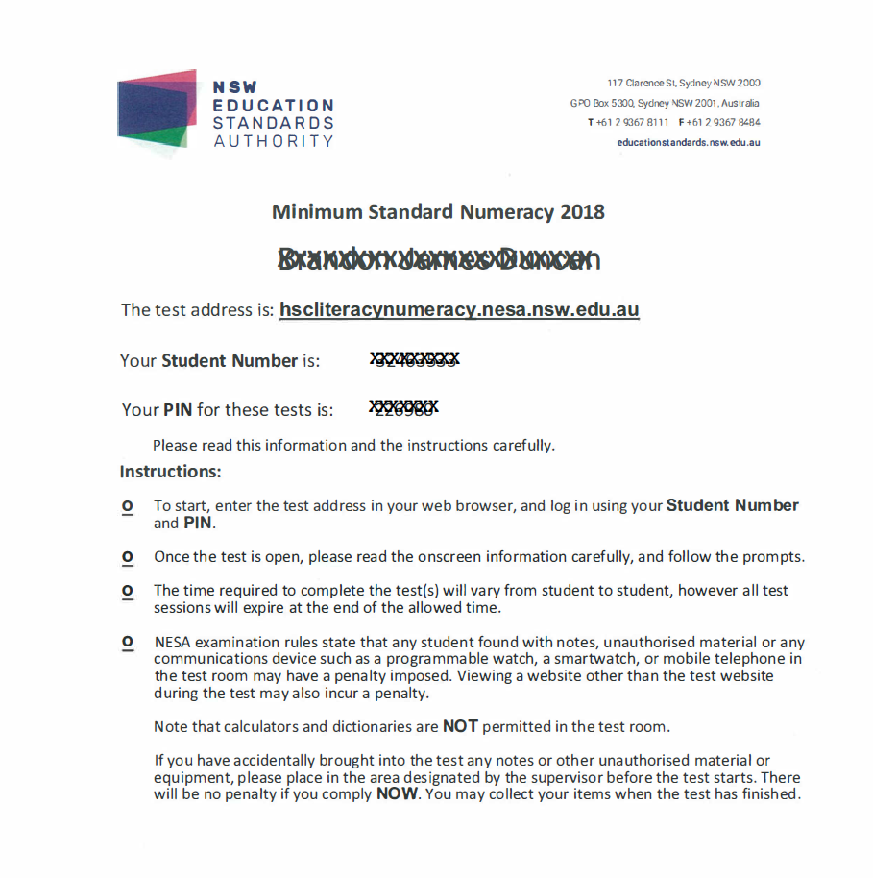
There are also practice tests (25 minutes) available in each area. Like the real tests, these are only available between 8am and 4pm on school days.

Slide 11
There are also practice tests (25 minutes) available in each area. Like the real tests, these are only available between 8am and 4pm on school days.
Both real & practice tests need a log-in letter, with a PIN.

Slide 12
There are also practice tests (25 minutes) available in each area. Like the real tests, these are only available between 8am and 4pm on school days.
Both real & practice tests need a log-in letter, with a PIN.
Real and practice tests can only be done on computers with the right software installed.

Slide 13
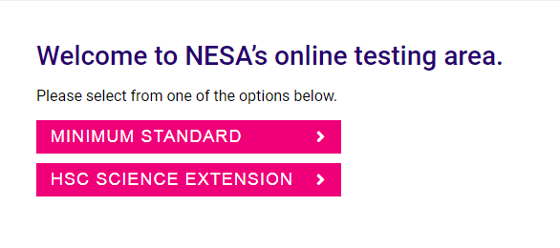
Log-in through the website address…..

Slide 14
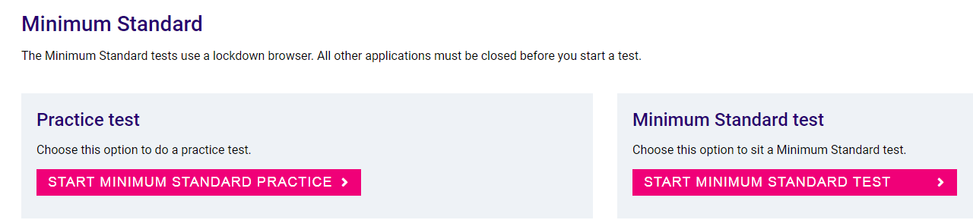
Log-in through the website address…..

Slide 15
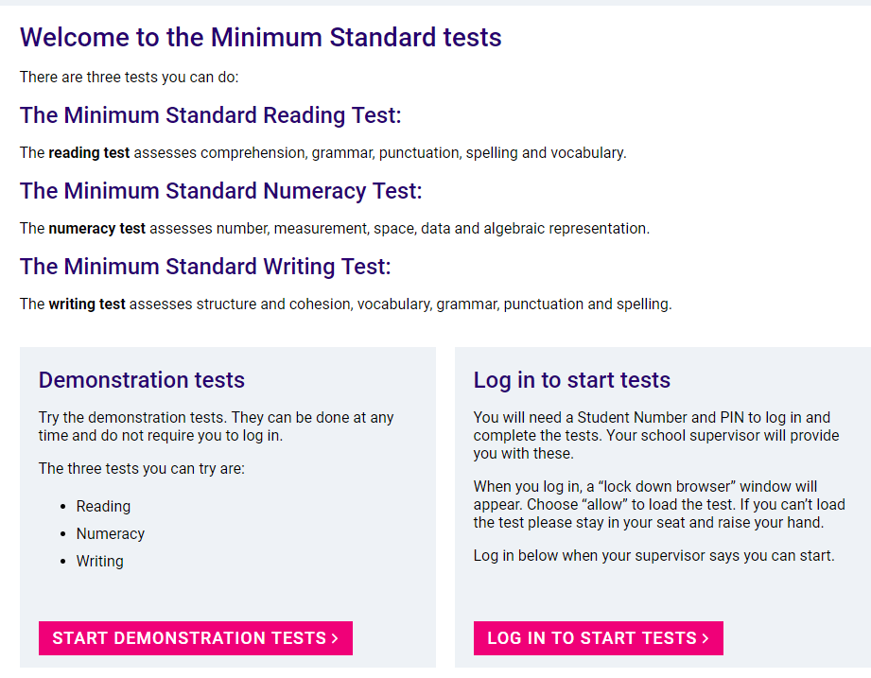
Log-in through the website address…..

Slide 16
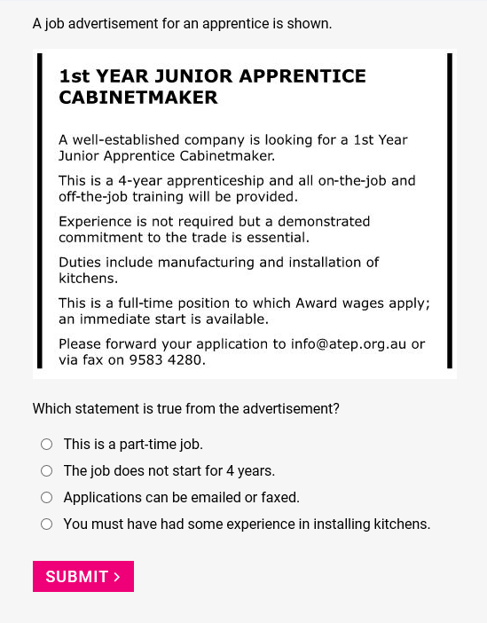
….and start answering questions.

Slide 17
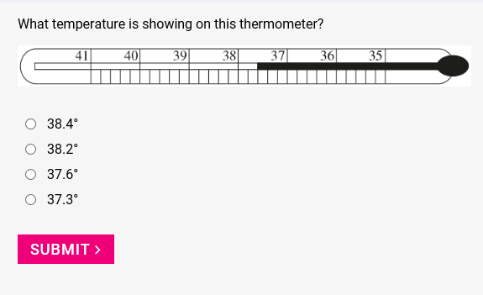
….and start answering questions.

Slide 18
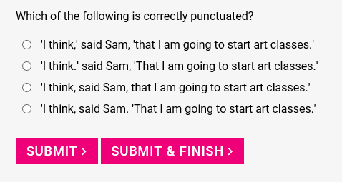
….and start answering questions.

Slide 19

You can change an answer, up until the time you click on “submit”.
For each question, the test will only let you choose one answer.
After clicking on “submit”, you can’t go back to that question, and you can’t change an answer.

Slide 20
In multiple-choice tests, think about each answer!!!

Slide 21
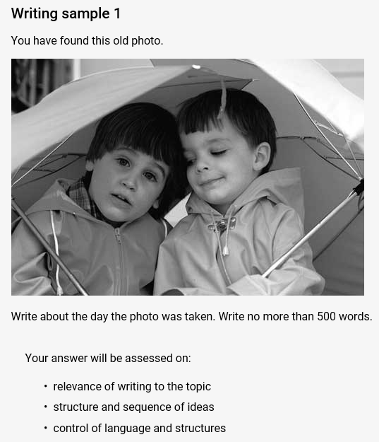
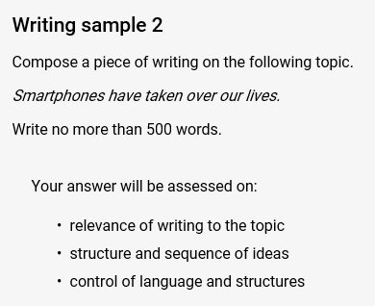
The writing question will have a choice….
or

Slide 22
For the writing, there’s a word-counter on screen…..
The word-counter tells you how many words you have used in your writing.
You don’t have to worry about going under 500 words…
…but don’t go over!

Slide 23

For the writing, there’s a word-counter on screen…..
The word-counter tells you how many words you have used in your writing.
You don’t have to worry about going under 500 words…
…and plan your writing, before you begin!
…but don’t go over!

Slide 24
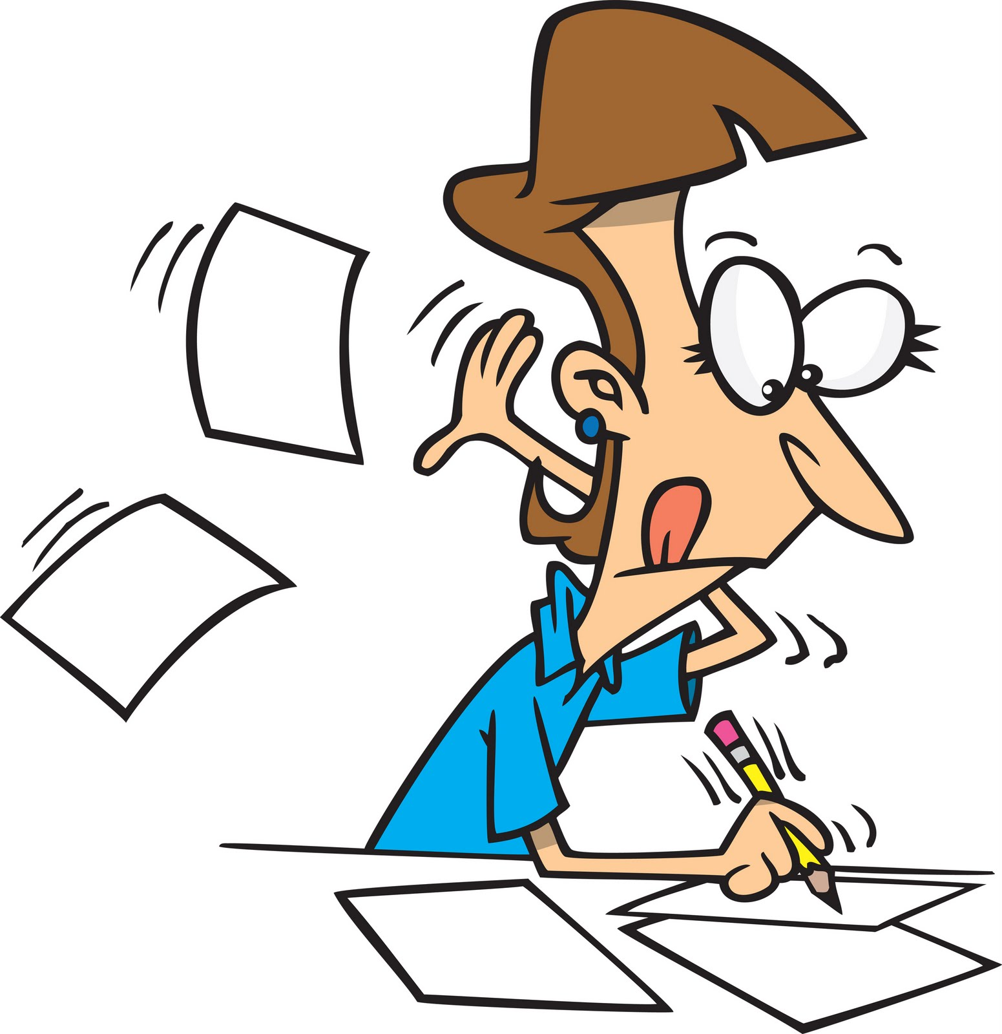
Problems with a lot of writing samples have been:
spelling of common words;

Slide 25
Problems with a lot of writing samples have been:
spelling of common words;
not having enough ideas, and not sticking to the topic;

Slide 26
Problems with a lot of writing samples have been:
spelling of common words;
not having enough ideas, and not sticking to the topic;
not using paragraphs (including an introduction and conclusion);

Slide 27
Problems with a lot of writing samples have been:
spelling of common words;
not having enough ideas, and not sticking to the topic;
not using paragraphs (including an introduction and conclusion);
not writing in sentences;

Slide 28
Problems with a lot of writing samples have been:
spelling of common words;
not having enough ideas, and not sticking to the topic;
not using paragraphs (including an introduction and conclusion);
not writing in sentences;
poor punctuation (especially capitals, full stops, commas and apostrophes);

Slide 29
Problems with a lot of writing samples have been:
spelling of common words;
not having enough ideas, and not sticking to the topic;
not using paragraphs (including an introduction and conclusion);
not writing in sentences;
poor punctuation (especially capitals, full stops, commas and apostrophes);
verbs not agreeing with the subject;

Slide 30
Problems with a lot of writing samples have been:
spelling of common words;
not having enough ideas, and not sticking to the topic;
not using paragraphs (including an introduction and conclusion);
not writing in sentences;
poor punctuation (especially capitals, full stops, commas and apostrophes);
verbs not agreeing with the subject;
mixing up tense; and

Slide 31
Problems with a lot of writing samples have been:
spelling of common words;
not having enough ideas, and not sticking to the topic;
not using paragraphs (including an introduction and conclusion);
not writing in sentences;
poor punctuation (especially capitals, full stops, commas and apostrophes);
verbs not agreeing with the subject;
mixing up tense; and
using informal language (eg, slang or texting language).

Slide 32
Here’s an example of some writing which did not pass…

Slide 33
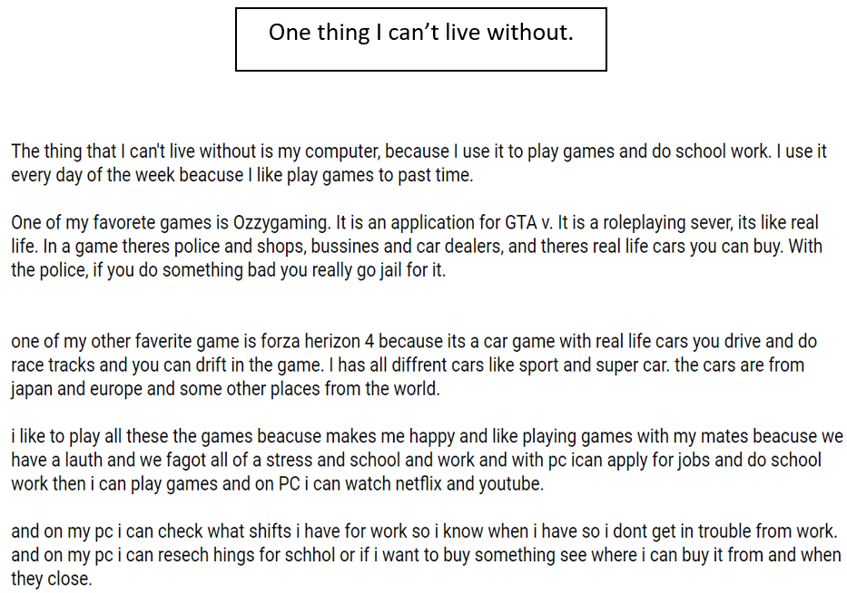

Slide 36
There will be tools to use. For example…..
clock

Slide 37
There will be tools to use. For example…..
clock
background colour,
print size & colour

Slide 38
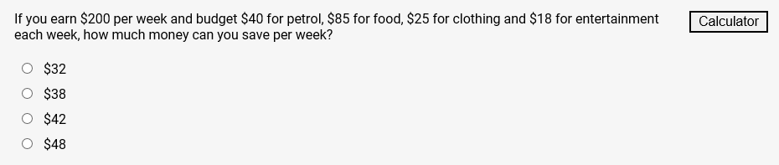
There will be tools to use. For example…..
clock
background colour,
print size & colour
calculator, when it is allowed

Slide 39

Test rules are simple….
no notes taken in
no mobile phones, calculators, or smartwatches
no communicating with other students
You can’t access any other websites.
You can do working-out, or write notes, on a blank piece of paper.

Slide 40

If you break the test rules….
You risk….
having that test result cancelled;
a lengthy ban from future tests; and
your parents (and you) getting a formal letter from NESA, telling you this.

Slide 41

Special circumstances….
Some students may be entitled to special test conditions (such as extra time, or having a reader). We will know about these, beforehand.

Slide 42
Special circumstances….
Some students may be entitled to special test conditions (such as extra time, or having a reader). We will know about these, beforehand.
If the test is interrupted (eg, from a power failure), you will not be disadvantaged.

Slide 43

For the actual tests, you’ll get your results through your Students Online accounts….
You’ll need your NESA numbers to access these; then, go into My Messages.

Slide 44
For the actual tests, you’ll get your results through your Students Online accounts….
You’ll need your NESA numbers to access these; then, go into My Messages.
Reading and numeracy results are usually very quick; writing takes up to 21 days.

Slide 45
Your results come in a report…
There are four levels of achievement. You need at least Level 3.

Slide 46
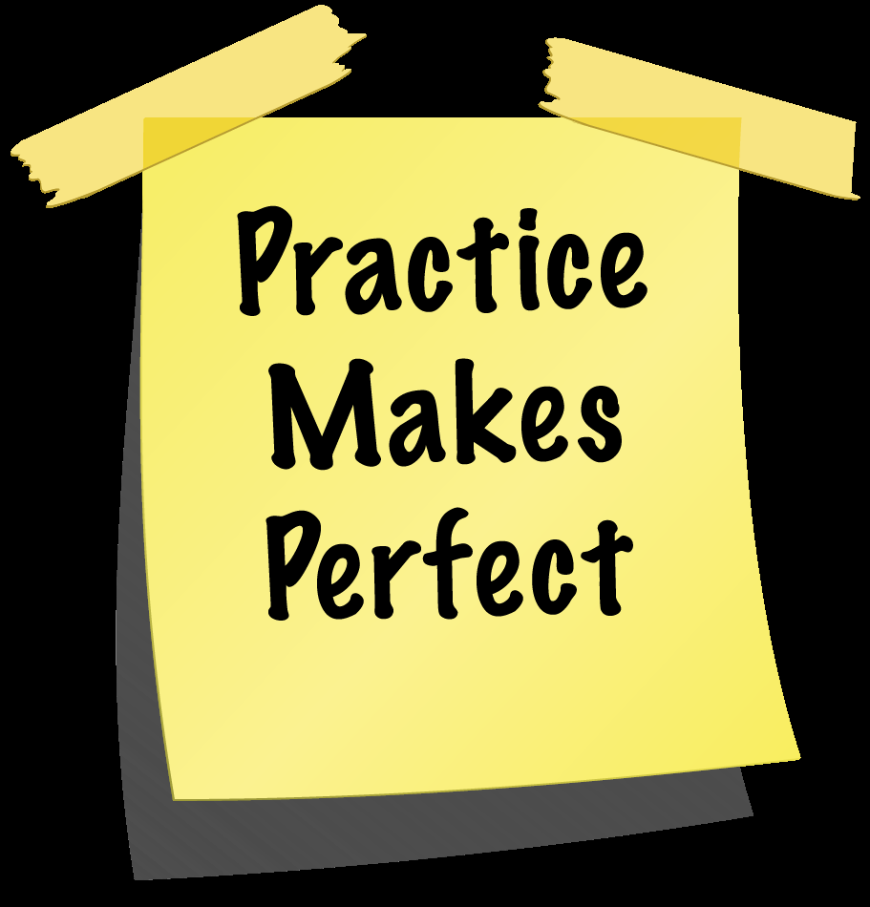
To get ready for the tests…..
Google “minimum standards tests”, and click on:
take a demonstration test, or
view sample questions and answers.
These need no log-in.

Slide 47
To practice for the tests…..
See me, to arrange for a practice test. Some practice tests will happen in English & Maths classes.
…or…
Check in to the Minimum Standards Preparation Google Classroom site, join-code fekslkn. The test schedule will be put on this site.

Slide 48

Each year, most Year 10 students get through….
Bring your best effort, and you’ll be fine!

