Slide 1
Doing NAPLAN online tests….

Slide 2
There are four tests:
writing test (42 minutes);
reading test (65 minutes);
language test (45 minutes); and
numeracy test (65 minutes).

Slide 3
There are four tests:
writing test (42 minutes);
reading test (65 minutes);
language test (45 minutes); and
numeracy test (65 minutes).
…and tests will be different to each other.

Slide 4
You will take the tests in Weeks 7, 8 and 9 of Term 1, in computer rooms.

Slide 5
You will take the tests in Weeks 7, 8 and 9 of Term 1, in computer rooms.
You can take in a sheet of blank paper and a pen. And you will need a set of headphones.

Slide 6
Log-in goes like this….

Slide 7
First, plug in your earplugs or headphones, and enter your user name & password.

Slide 8
2024

Slide 9
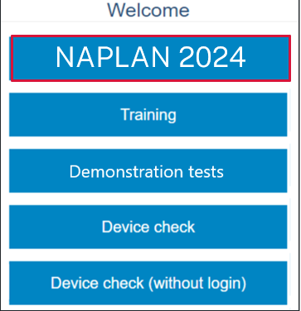
2024

Slide 10
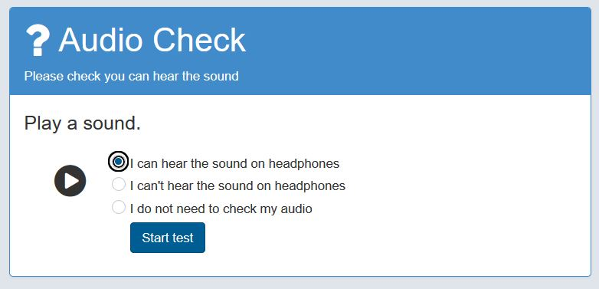
2024

Slide 11
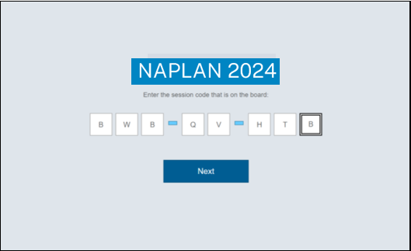

Slide 12
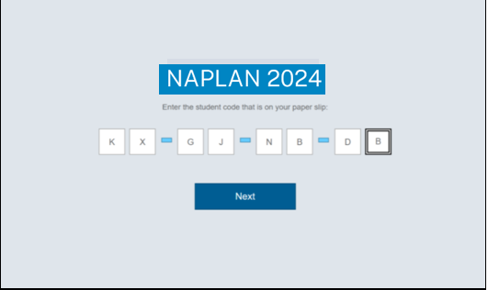

Slide 13
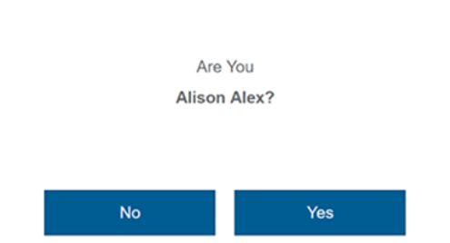

Slide 14
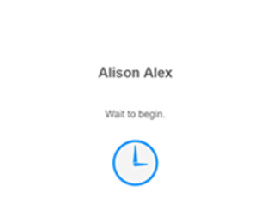

Slide 15
Types of questions you may get….

Slide 16
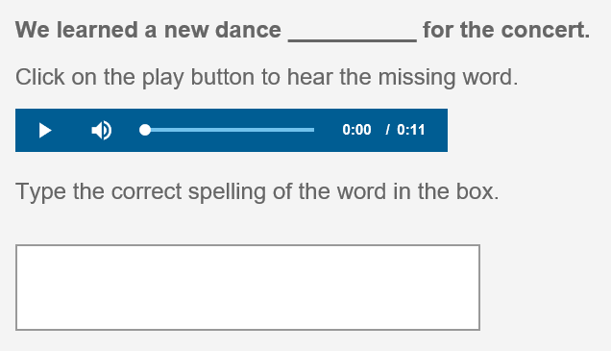

Slide 17
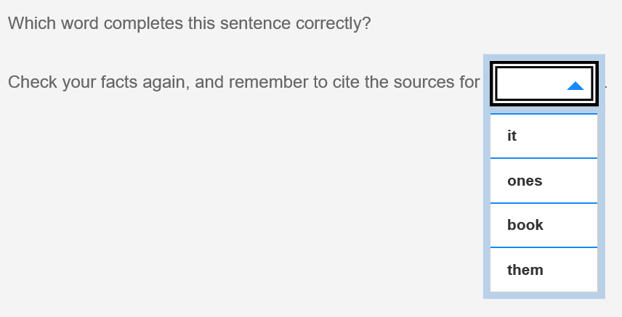

Slide 18
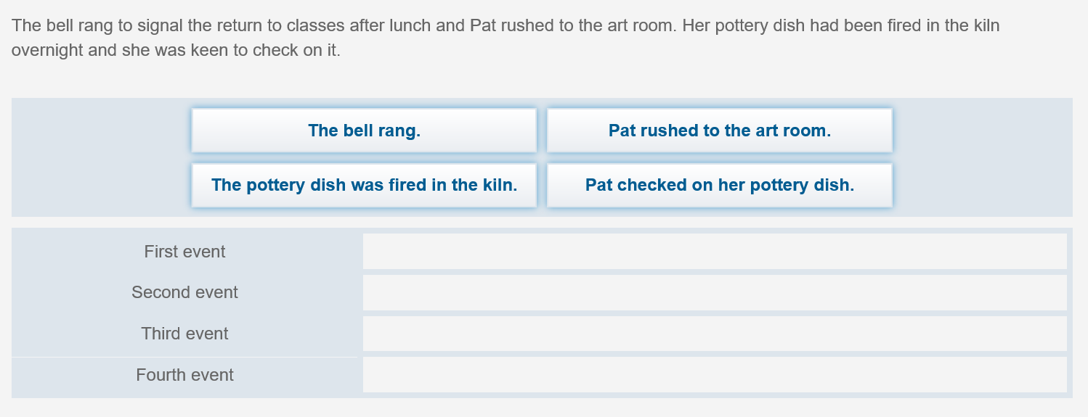

Slide 19
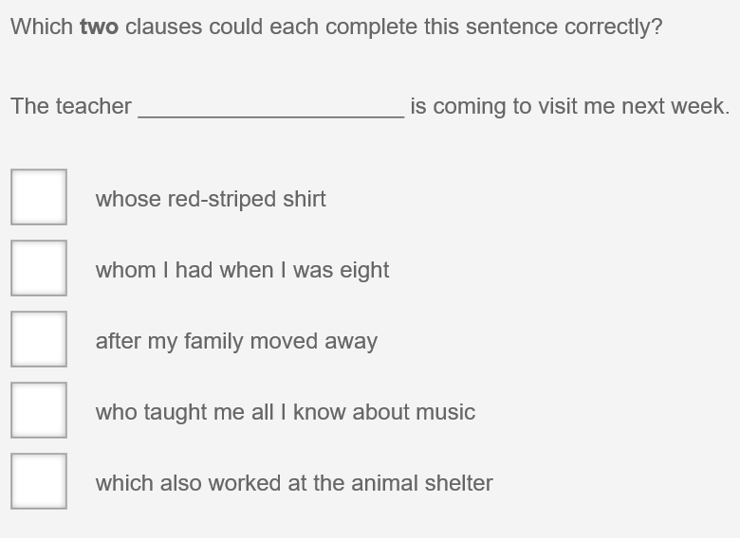

Slide 21
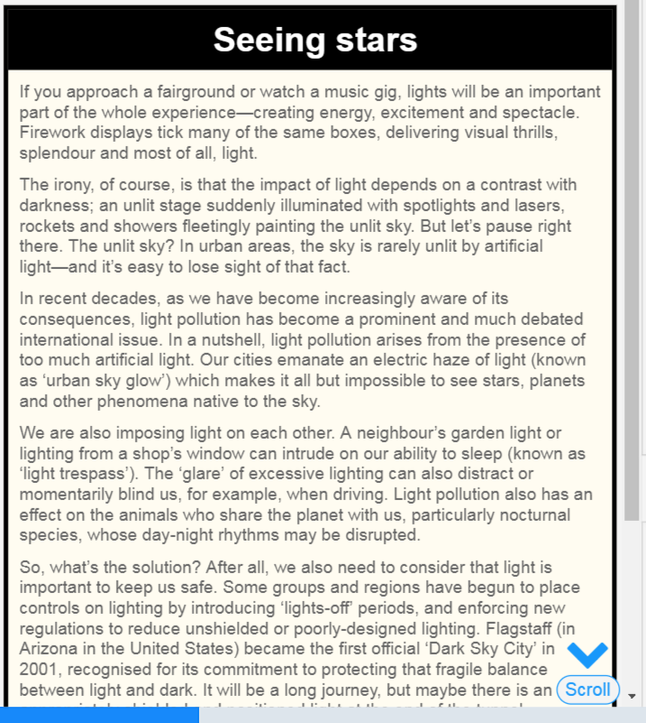

Slide 22
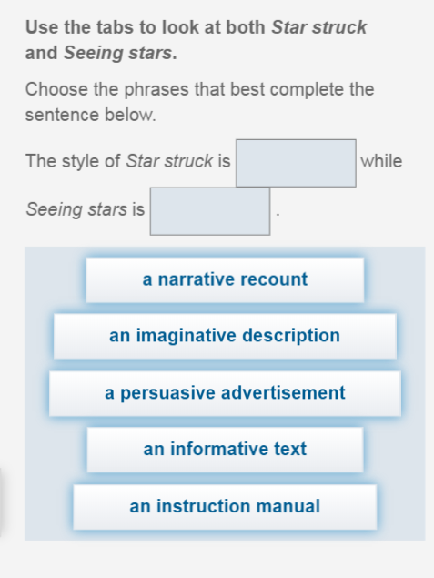

Slide 23
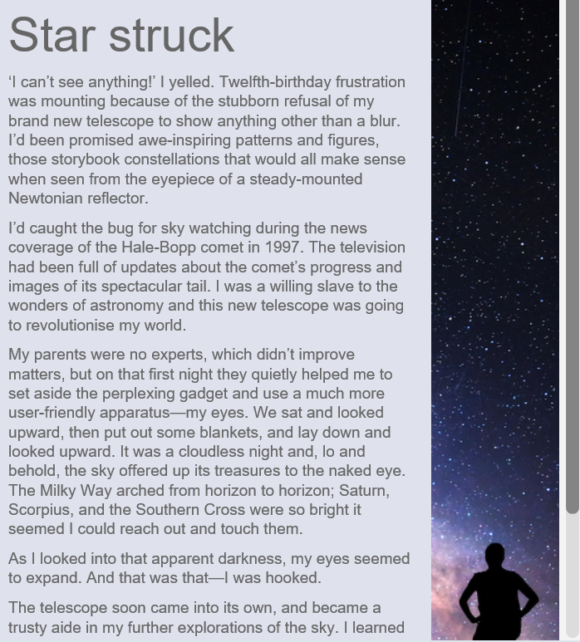

Slide 24
The writing question will be a narrative or a persuasion….

Slide 26
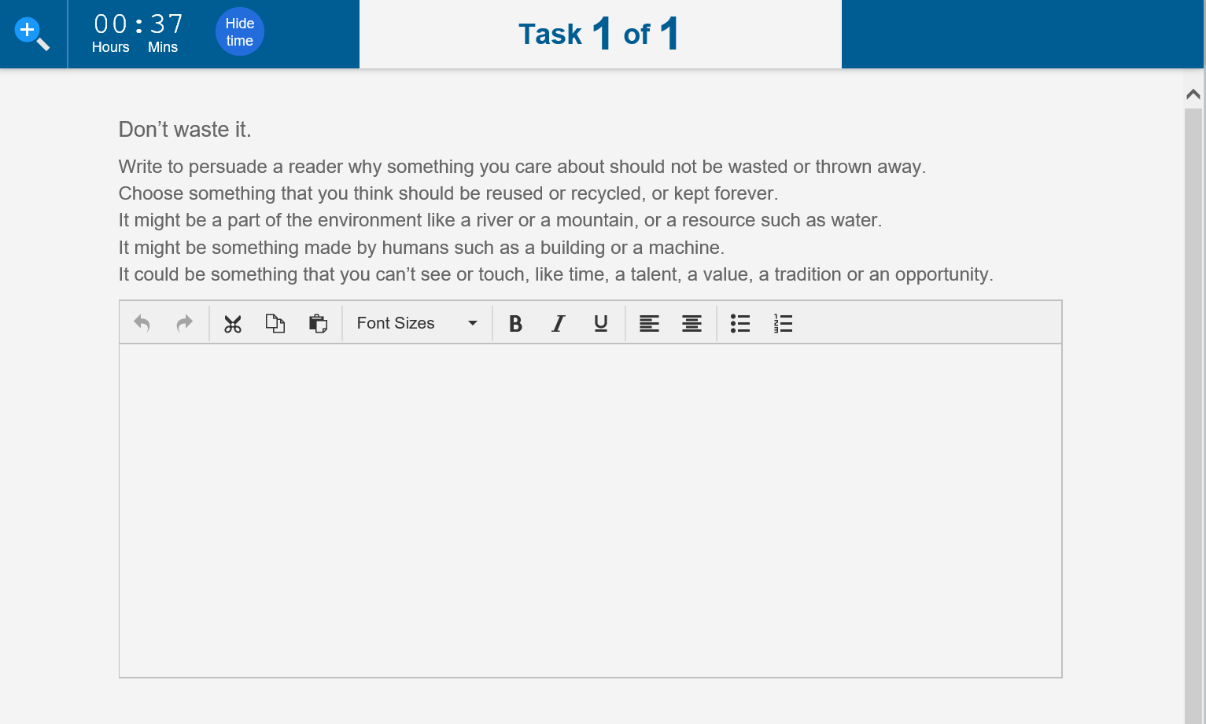

Slide 27
For the writing, there’s no real rule about how much you write…..

Slide 28
For the writing, there’s no real rule about how much you write…..
But remember to:
plan before you start
use paragraphs
write in sentences
watch spelling and punctuation
check your writing at the end

Slide 29
Navigating questions….

Slide 30
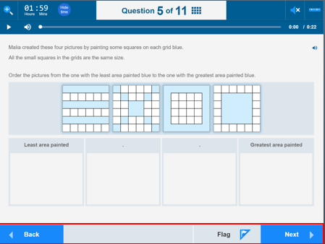
You can go forwards, backwards, or flag a question to come back to later.

Slide 31
You can also zoom in or out, check the time remaining, listen to the audio, or change the screen colour.

Slide 32
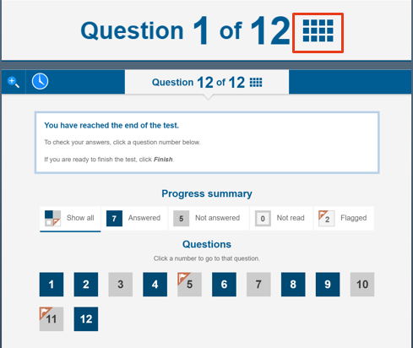
Clicking on the grid at the top will let you look at all the questions you have already done, and go back to any you want to.

Slide 33
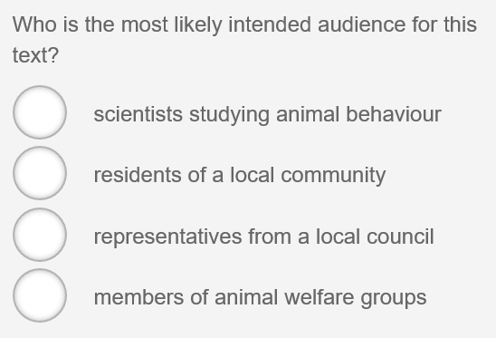
If you change an answer, you must de-select the old answer first.

Slide 34
And in the numeracy test, a ruler, protractor and calculator can be used for some questions.

Slide 35
At different stages, you may see these boxes….

Slide 36
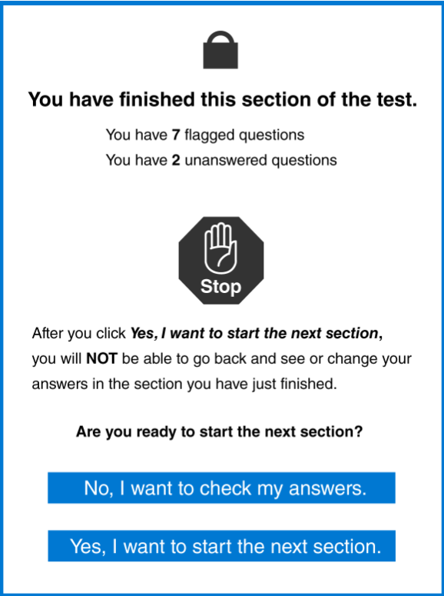
You may see these:
after the calculator section, in numeracy;
after the spelling section, in the reading;
or
when the level of questions is about to change.

Slide 37
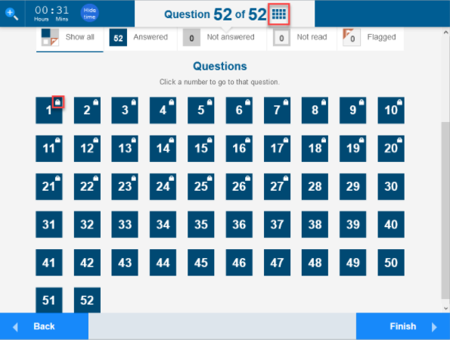
Questions you can’t go back to.

Slide 38
At the end of the test….

Slide 39
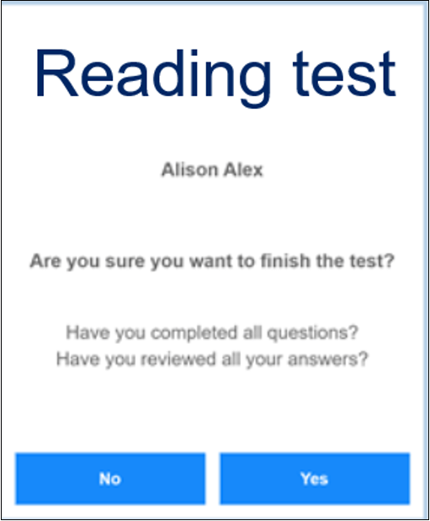

Slide 41
Don’t click on Finish while you still have time left!

Slide 42
Test rules….

Slide 43
Test rules are simple….
no notes taken in;
no mobile phones, calculators, or smartwatches; and
no communicating with other students.
You can’t access any other websites.
You can do working-out, or write notes, on a blank piece of paper.

Slide 44
If you break the test rules, or make a non-serious attempt….
You risk….
being reported to NESA, the test organisers; and
having your test stopped, and being moved to a different location.

Slide 45
Special conditions….

Slide 46
Some students may be entitled to special test conditions (such as extra time, or having rest breaks). We will know about these, beforehand.

Slide 47
Some students may be entitled to special test conditions (such as extra time, or having rest breaks). We will know about these, beforehand.
If the test is interrupted (eg, from a power failure), you will not be disadvantaged.

Slide 48
For more practice, you can do the demonstration test, to see all the different kinds of questions……
Just
NAPLAN online public demonstration site.

Slide 49
The NAPLAN tests give a very good idea about skills you will need for life and further study, and provide a detailed report to parents.

Slide 50
The NAPLAN tests give a very good idea about skills you will need for life and further study, and provide a detailed report to parents.
Bring your best effort, and you’ll be fine!

